Slide 1


Hamza: AI Personal Assistant
Submitted By
MD Parvez Mussaruf Registration No: 18502003564 Session : 2018-2019 |  | Rifatul Mostafa Registration No: 18502003 Session : 2018-2019
Department of Computer Science and Engineering (CSE) Institute of Science and Technology (IST) 02 June, 2024

Slide 2
Content List
Introduction
Motivation
Objective
Existing System Overview
Drawbacks of Existing System
Work Flow Diagram
E-R Diagram
Level- 0 DFD
Level- 1 DFD
Use Case Diagram
Proposed System Features
Platform Overview
Implementation
Testing
Comparison
Conclusion
Future Work

Slide 3
Introduction
“Hamza: AI Personal Assistant” leverages the latest advancements in artificial intelligence and natural language processing to provide a seamless, interactive experience.
The ability to understand and respond to voice commands, Hamza can perform a wide range of tasks, from answering questions and managing your schedule to playing music and searching the web..

Slide 4
Motivation
Boost Efficiency:Hamza saves time by streamlining tasks and providing quick, accurate responses.
Natural Interaction:With advanced speech recognition, Hamza offers an intuitive, user-friendly experience.
Personalized Help:Hamza adapts to user needs with intelligent, context-aware responses for a tailored experience.

Slide 5
Objective
Automate Daily Tasks: Streamline routine activities through efficient voice commands.
Provide Seamless Interaction:Offer a user-friendly and intuitive interface with advanced speech recognition.
Deliver Personalized Assistance:Adapt to individual user needs with intelligent, context-aware responses.
Enhance Productivity:Save time and increase efficiency by managing schedules and accessing information quickly.

Slide 6
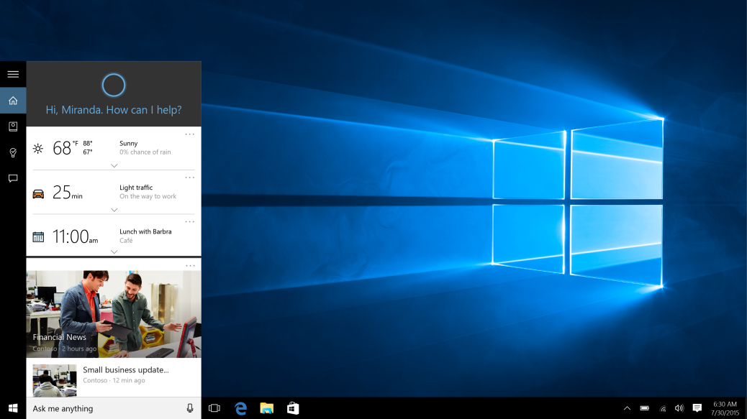
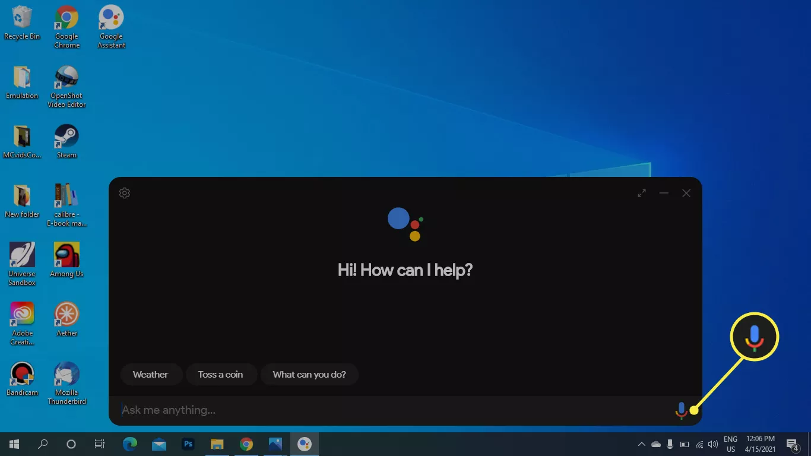
Existing System Overview
Cortana (Microsoft):
Google Assistant:

Slide 7
Drawbacks of Existing System
Primarily integrated into Windows operating systems, with limited support on other platforms. (Cortana)
Deep integration with Microsoft services but limited third-party service integration. (Cortana)
Offers some customization options, but these are relatively limited compared to open-source alternatives.(Google assistant)
Response time can be slow, especially when handling complex queries or accessing third-party services.(Google assistant)

Slide 8
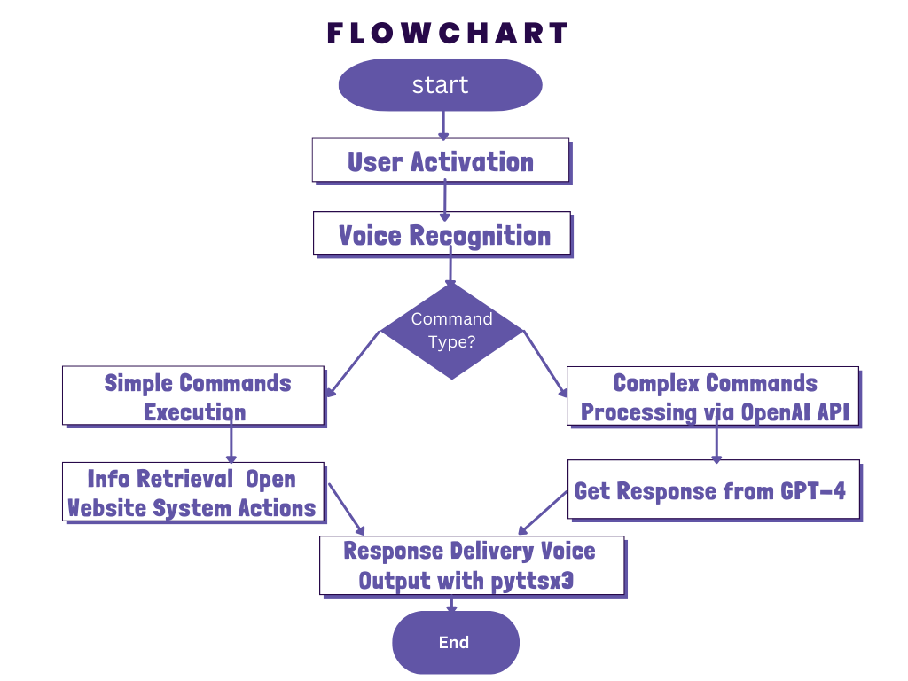
Proposed System Design
Fig: Work Flow Diagram

Slide 9
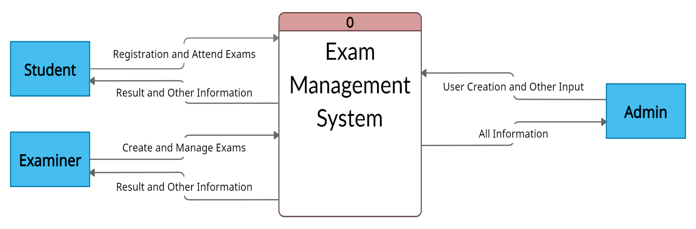
Proposed System Design
Fig: Level 0 DFD

Slide 10
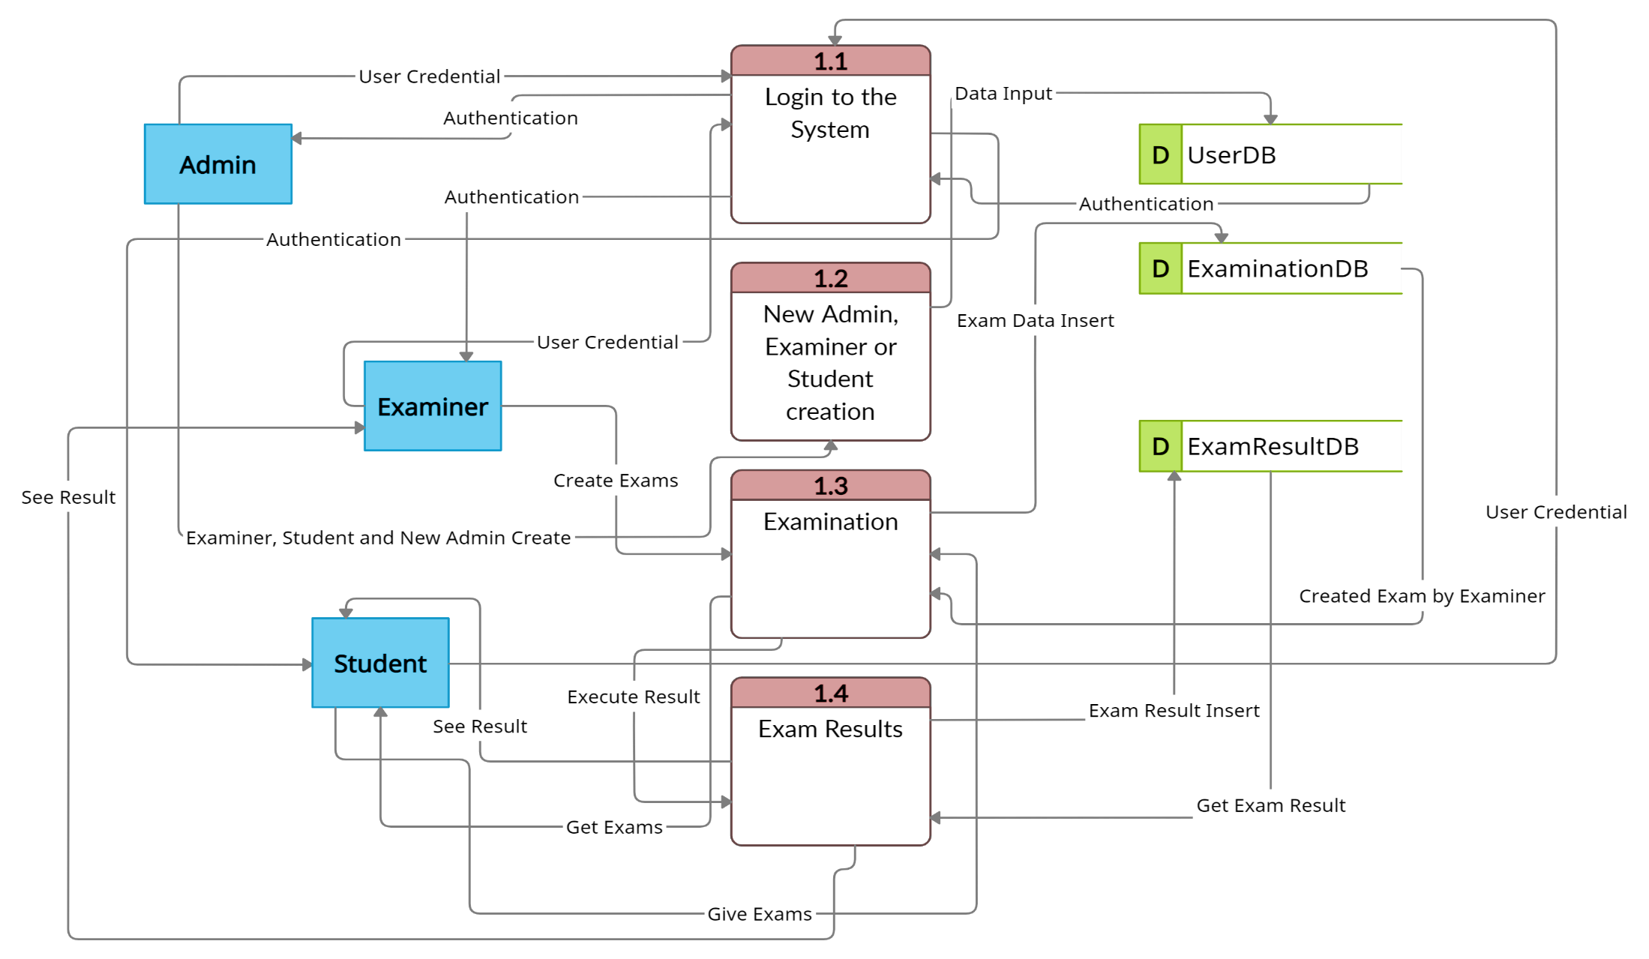
Proposed System Design
Fig: Level 1 DFD

Slide 11
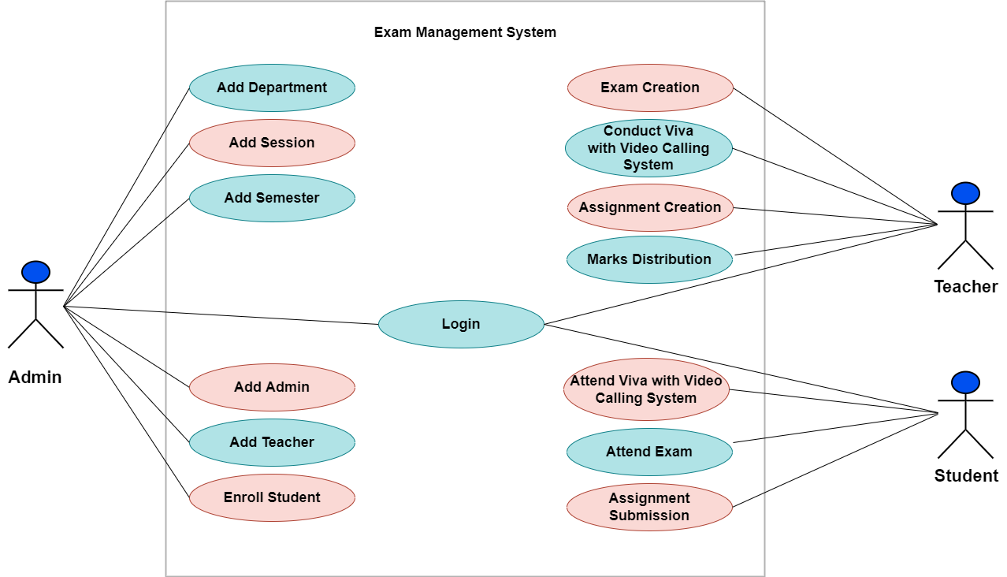
Proposed System Design
Fig: Use Case Diagram

Slide 12
Proposed System Features
Provide a video calling system for taking online viva.
Teachers can upload their questions whenever they want and fix the exam time and the questions will be visible to the students when it's time for the exam.
For Written exam pdf/doc file option will be added and the submit button will vanish when time is up.
For the MCQ exam, teachers can upload the answers along with the question and when the exam time is up, students will see their marks instantly.
Auto submit answers when the time is up

Slide 13
Required Tools
SL | Hardware | Software
01 | OS independent | Java 1.8
02 | Processor Base Frequency of 1.8 GHz or higher. | Maven 3.0+
03 | 8 GB RAM or more. | Spring Framework 5.0.0.BUILD-SNAPSHOT.
04 | 10 GB of available disk space or more. | An IDE (Spring Tool Suite) is recommended.
05 |  | Node 10.0.2

Slide 14
Platform Overview
SL | Backend | Frontend
01 | Java | HTML
02 | Spring Boot | CSS
03 | Spring Data JPA | Bootstrap
04 | MySQL | JavaScript
05 | Firebase | React

Slide 15
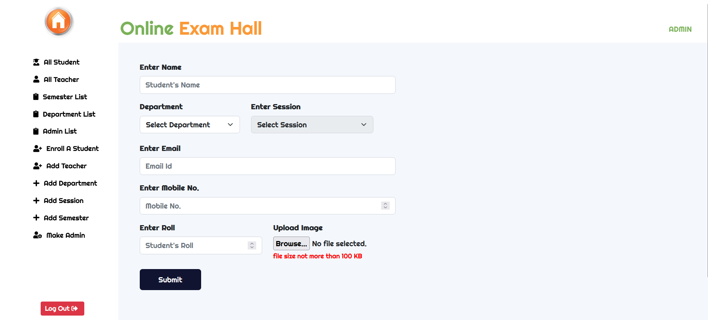
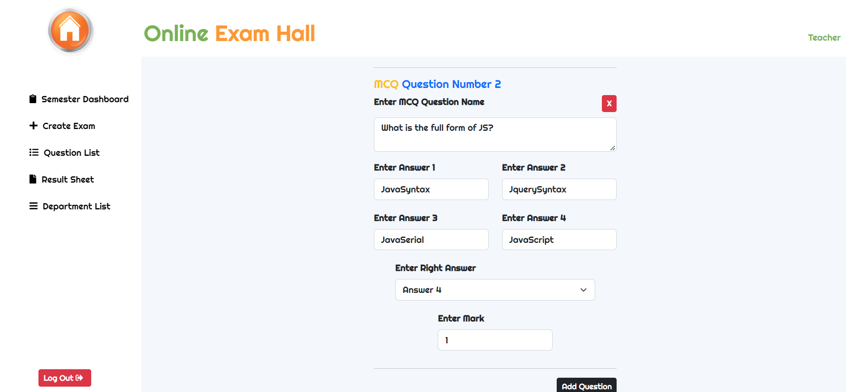
Implementation
Here we create a profile.
Fig: Profile creation page
Here we create a question.
Fig: Question creation page

Slide 16
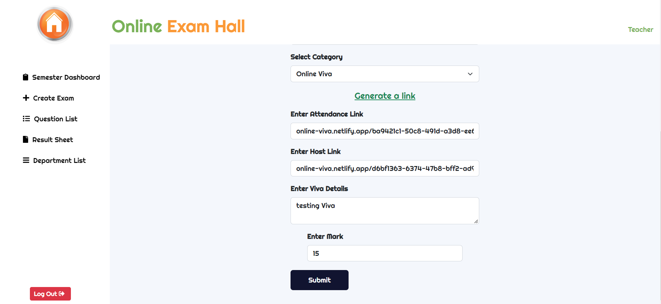
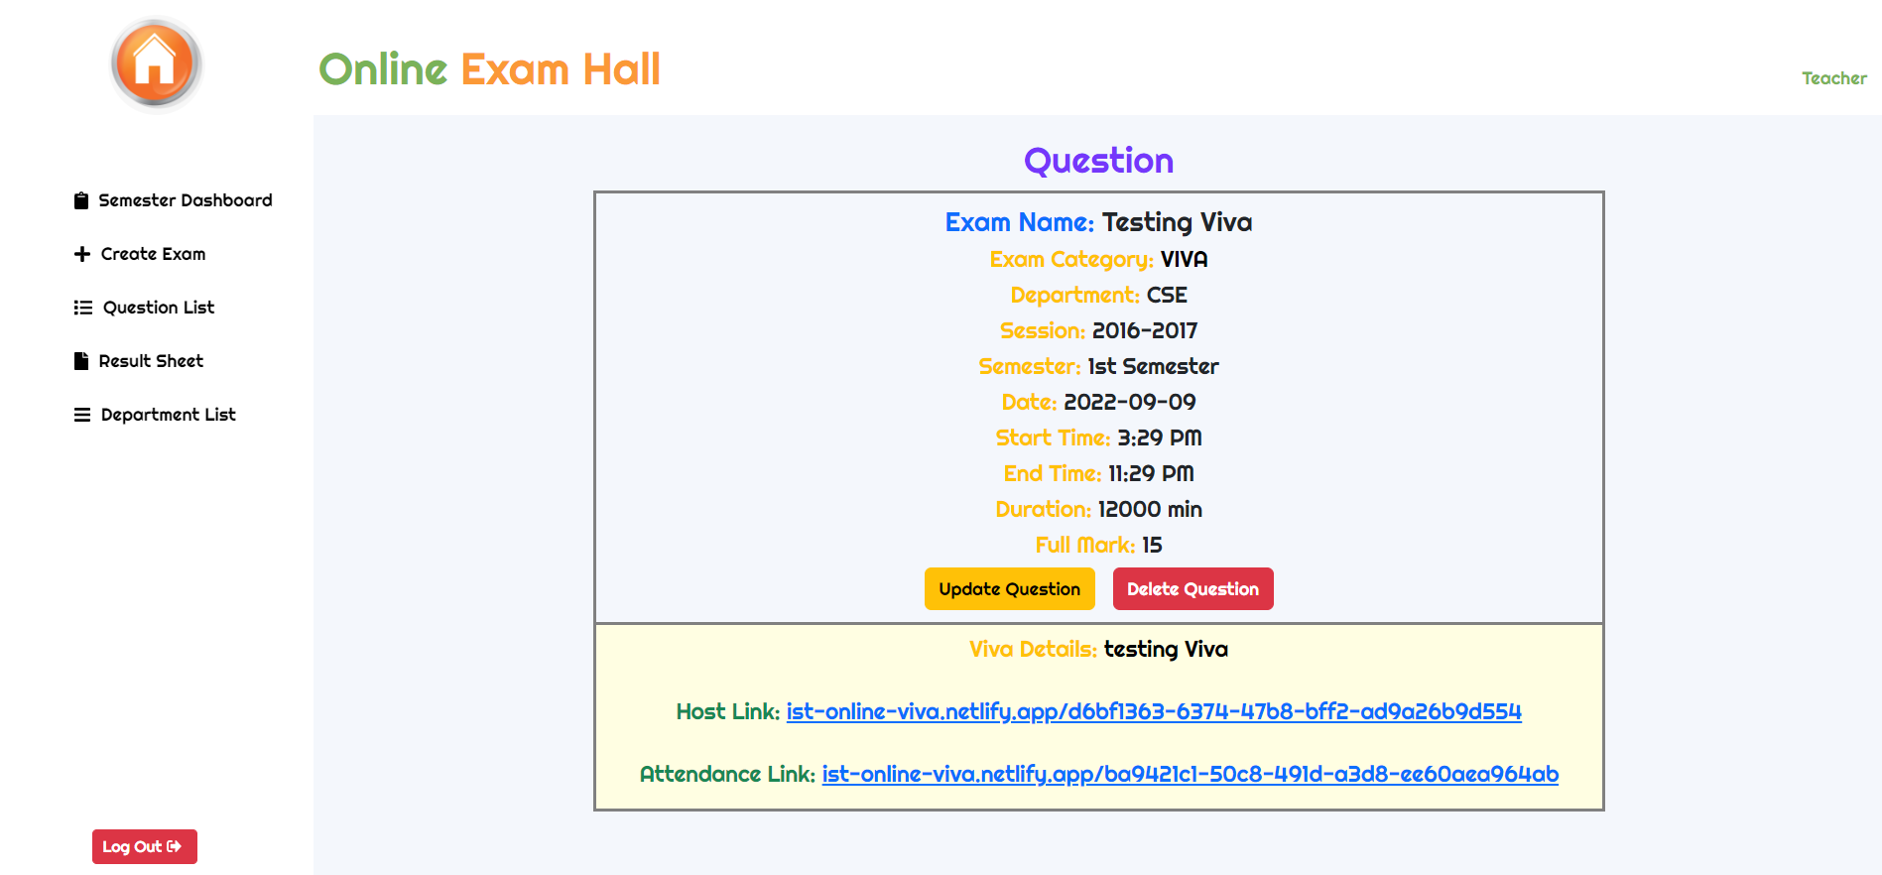
Implementation
Here we create an online viva with video calling system.
Fig: VIVA creation page
Here we can see the created viva link of video calling system.
Fig: VIVA details page

Slide 17
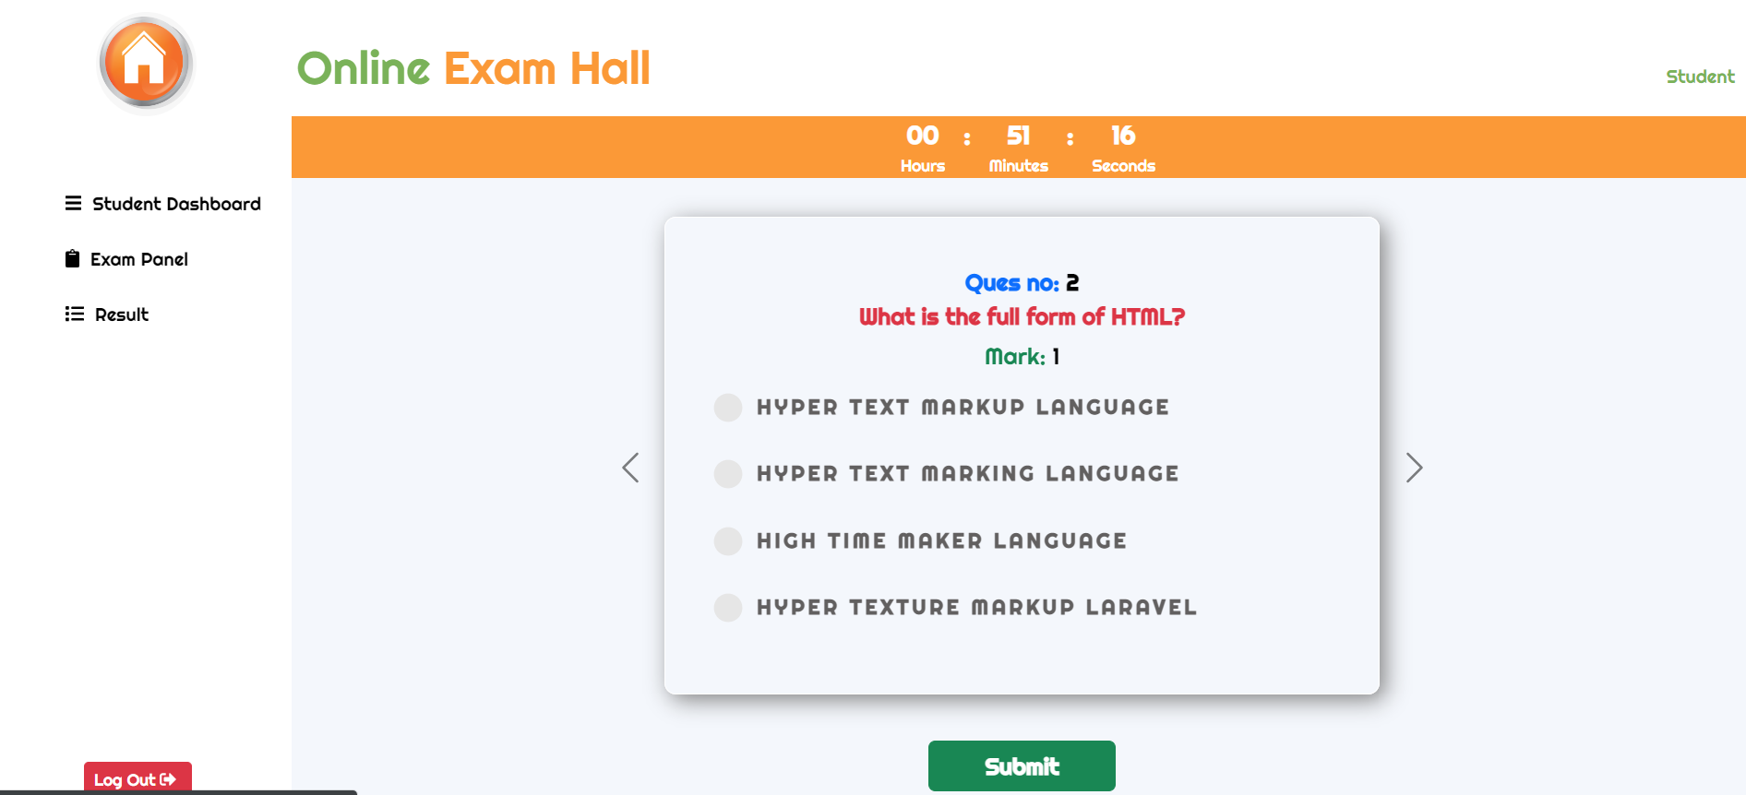
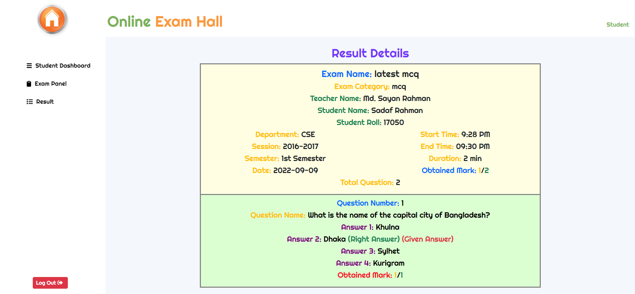
Implementation
Here we can see the MCQ exam page.
Fig: MCQ exam page
Here we can see the MCQ result page.
Fig: MCQ result page

Slide 18
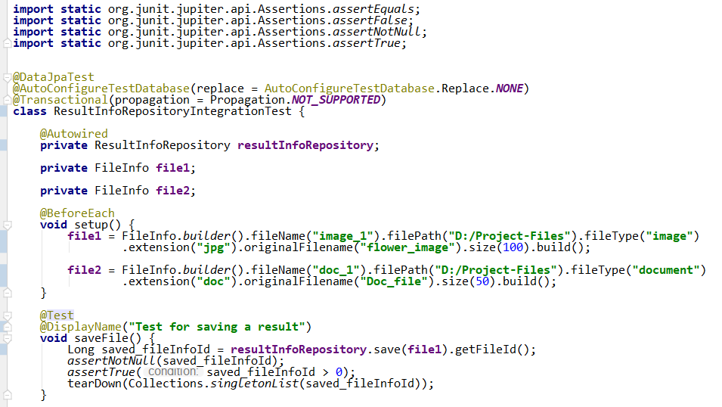
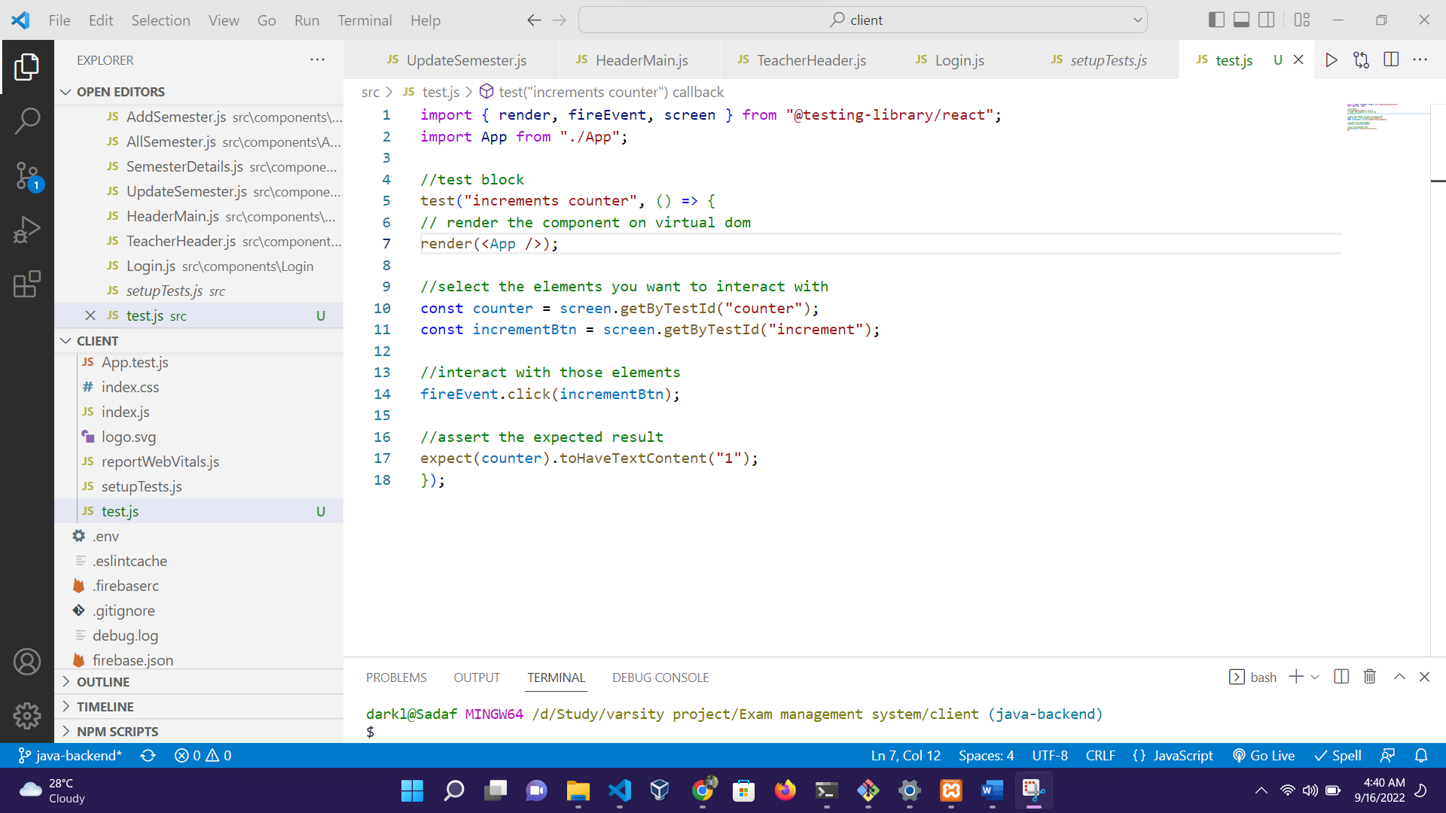
Test Result
Fig: Unit test case of Result Repository
Fig: Unit test case of App component

Slide 19
Comparison
Case | Existing Systems |  | Proposed System
 | TestGorilla | Schoology | IST Online Exam Hall
Auto Submit | Yes | No | Yes
Registration | Yes | Yes | Yes
Paper leakage | Yes | Yes | No
Video Calling System | Yes | No | Yes
Paid | Yes | Yes | No
AI integration | Yes | No | No

Slide 20
Conclusion
The Exam Management System will reduce the manual works for an institution and automate the whole examination and viva criteria.
It will be institute based. That means all of the data/information will be kept in institute servers.
The business criteria will be different than Schoology and TestGorilla. Like, Schoology allows submitting the answers after the time limit. But in our proposed system answers will be automatically submitted after the time limit.

Slide 21
Future Work
Add mail service: Users can be notified with mail on different cases.
AI integration: Different types of AI features enable for prevention of cheating and proper automated monitoring of the exam.
Marksheet and Report Generation: Result sheets or Marksheets can be generated from the system for the students. Certificates and different types of Reports can be provided from the system.
Mobile app: The mobile app can be developed for making the system handy to the users.

